Slide 1
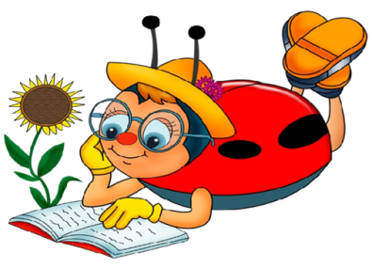
2015 Summer Language Camp
Magic Camp
Communication
Fun Activities
Recreation
Interaction
Learning
Sokolivochka School
Done by Valentyna Shynkariuk

Slide 2
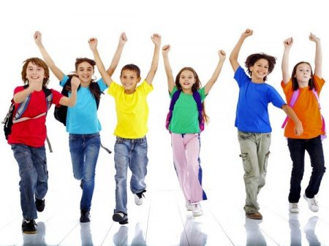
The Motto іs:
“Learn and Discover
the World!”

Slide 3
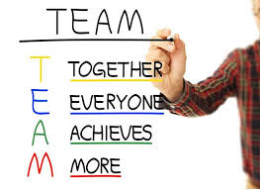

Slide 4
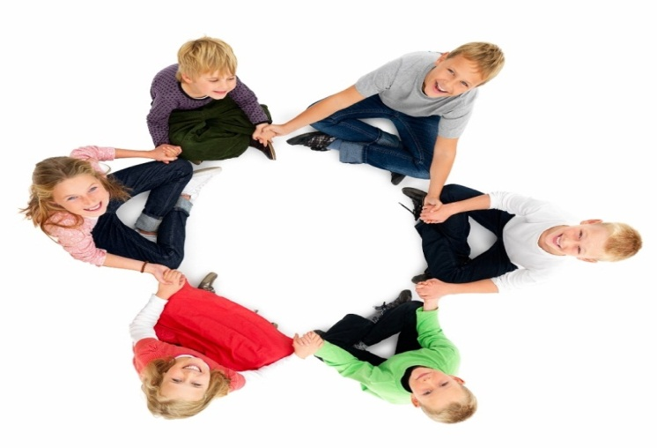
The main purpose of language camp
to increase the interest of students to study English,
promotion of English language to motivate students to learn English,
formation of communicative competence,
the development of the creative potential of every child,
education communication needs in the knowledge of other countries and people.
The basic principles of language school are
principle of communication training with life;
principle of communicative activity of students;
principle of due extracurricular activities with foreign language lessons.

Slide 5
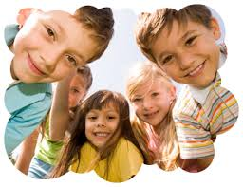
Camp Rulers
RESPECT Your Environment—Respect One Another—Respect Yourself.
Be Positive—Don’t Criticize, Encourage.
Be a good example to others.
Play together as a team.

Slide 6
Саmp schedule
9.00-9.30 Students arrive;
Ice breaker and warm up
9.30-10.15 First class
10.15-10.30 Teambuilding games
10.30-11.15 Second Class
11.15-11.45 Lunch/Break
11.45-12.30 Fun Activities
12.30- 14.00 Your favourite films/cartoons in English
14.00 Home

Slide 7
Camp Song
If You're Happy and You Know It
If you're happy and you know it, clap your hands (clap clap) If you're happy and you know it, clap your hands (clap clap) If you're happy and you know it, then your face will surely show it If you're happy and you know it, clap your hands. (clap clap) If you're happy and you know it, stomp your feet (stomp stomp) If you're happy and you know it, stomp your feet (stomp stomp) If you're happy and you know it, then your face will surely show it If you're happy and you know it, stomp your feet. (stomp stomp) If you're happy and you know it, shout "Hurray!" (hoo-ray!) If you're happy and you know it, shout "Hurray!" (hoo-ray!) If you're happy and you know it, then your face will surely show it If you're happy and you know it, shout "Hurray!" (hoo-ray!) If you're happy and you know it, do all three (clap-clap, stomp-stomp, hoo-ray!) If you're happy and you know it, do all three (clap-clap, stomp-stomp, hoo-ray!) If you're happy and you know it, then your face will surely show it If you're happy and you know it, do all three. (clap-clap, stomp-stomp, hoo-ray!)

Slide 8
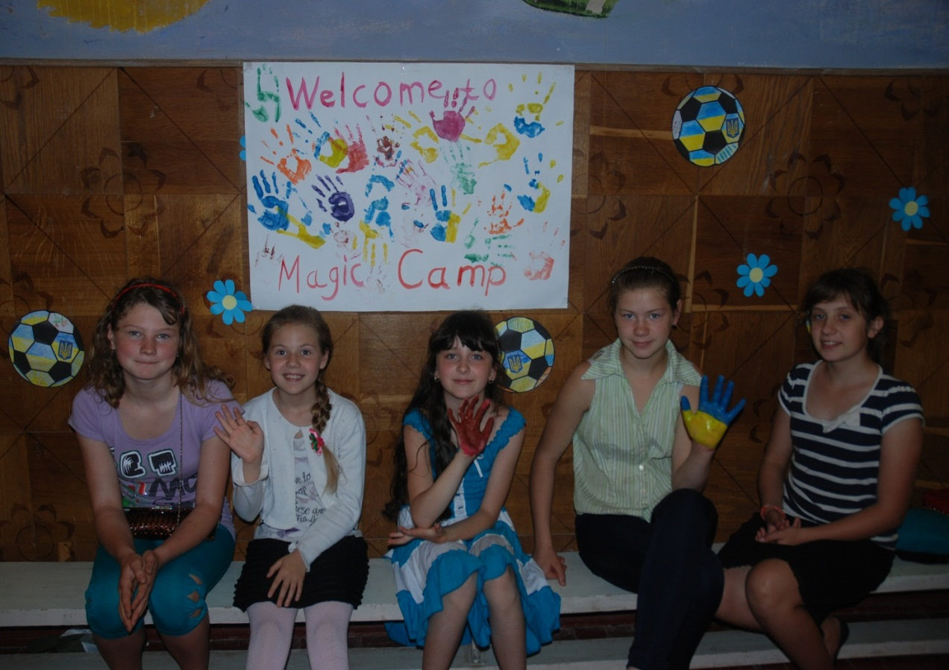
Welcome
to the Magic Camp

Slide 9
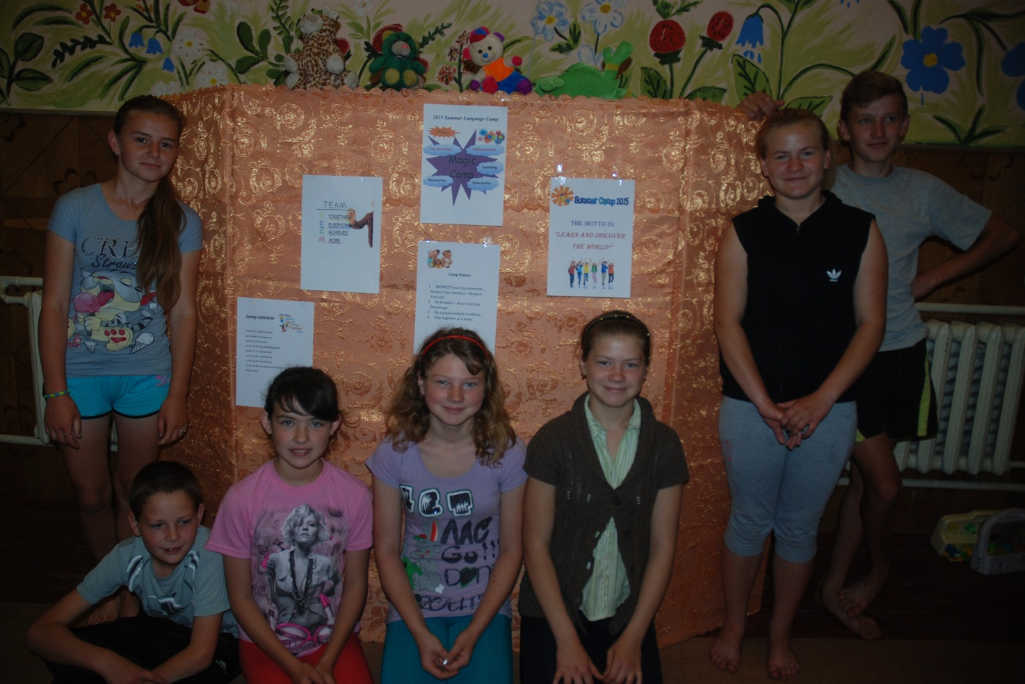
English Play

Slide 10
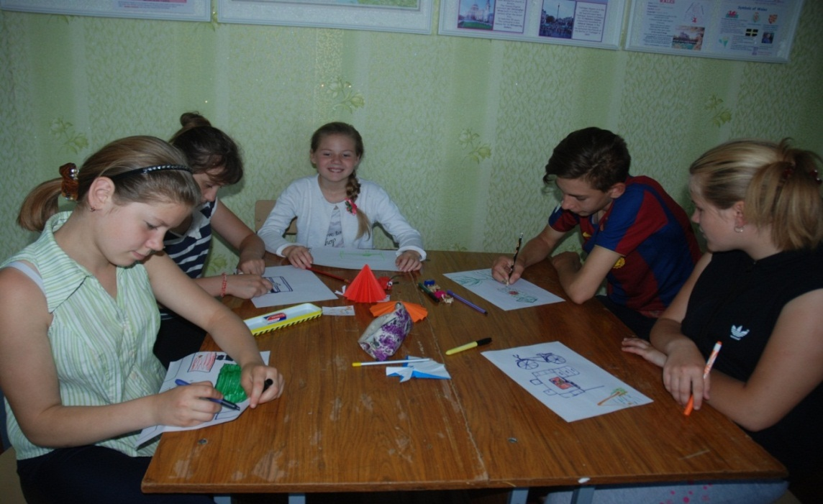
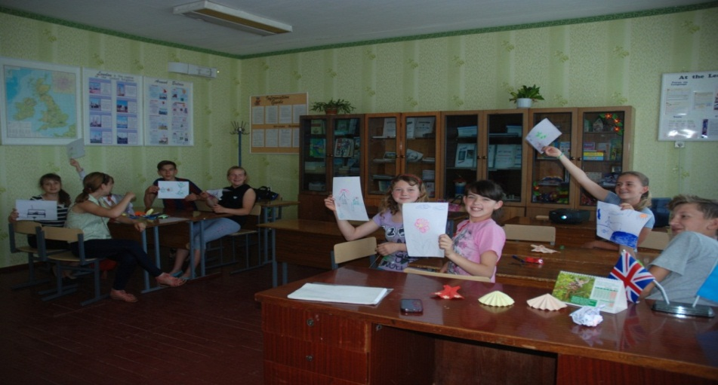
Group Work

Slide 11
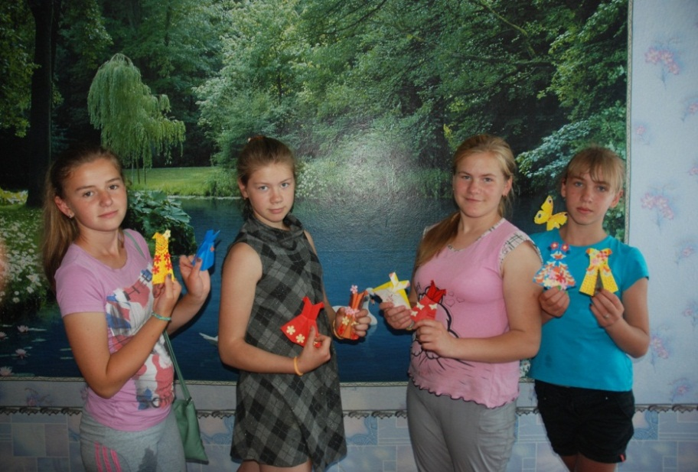
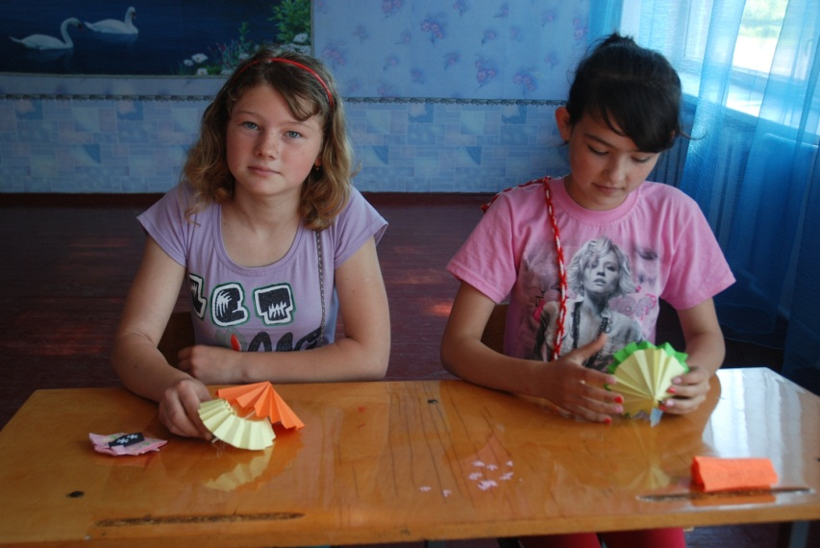
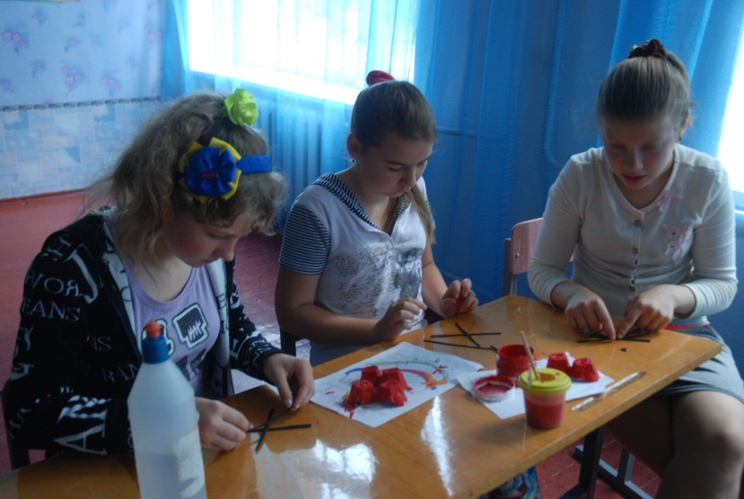
DIY

Slide 12
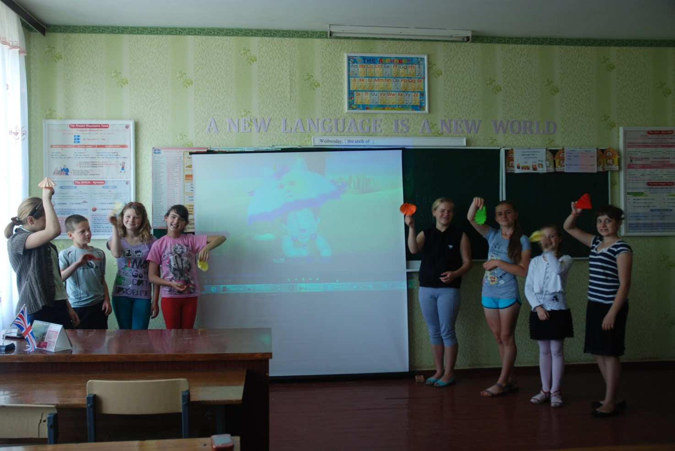
We like English songs

Slide 13
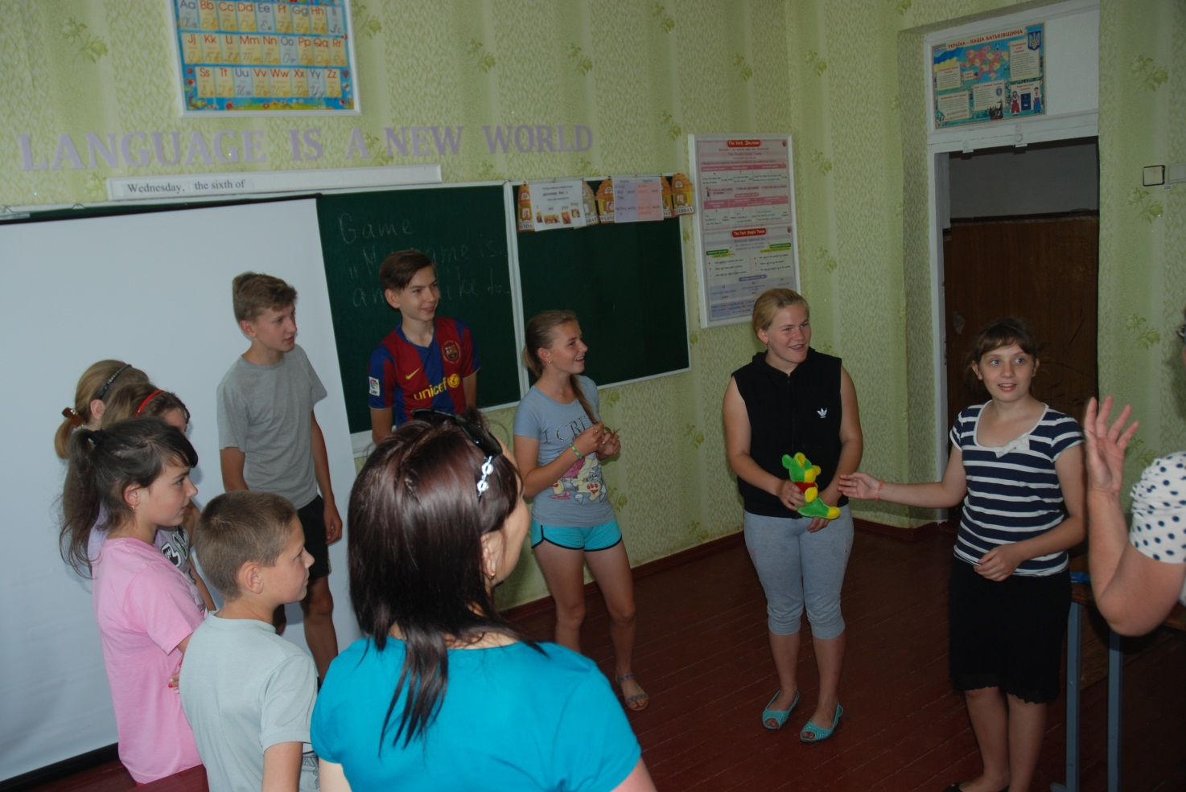
Playing games

Slide 14
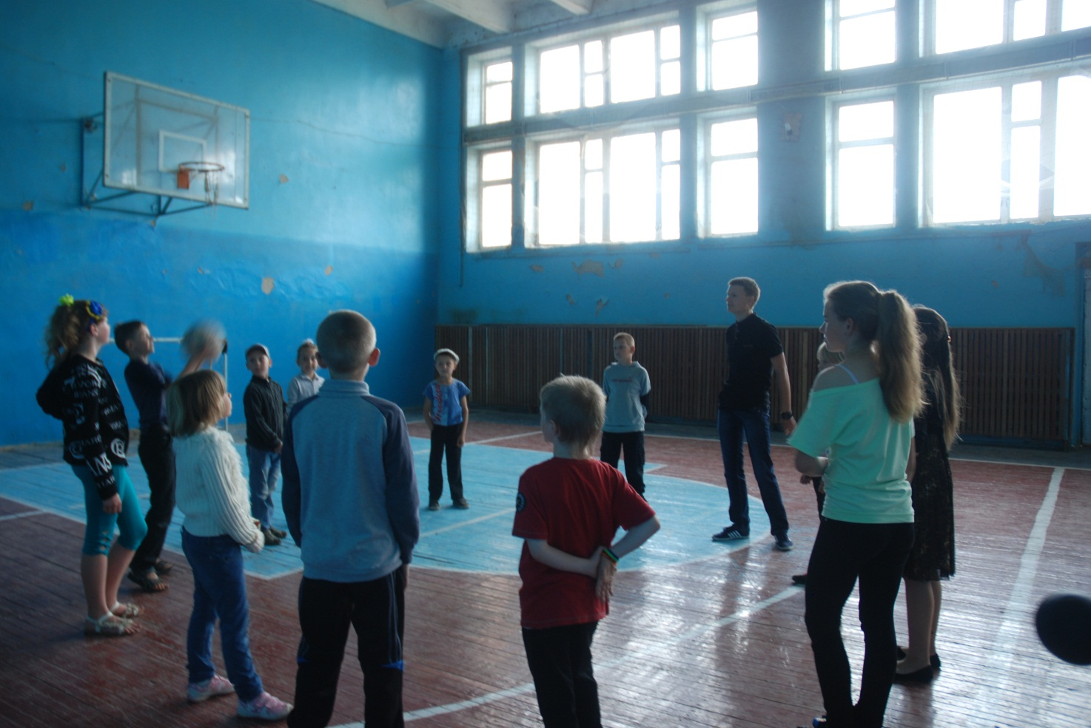
Playing Sports Games

Slide 15
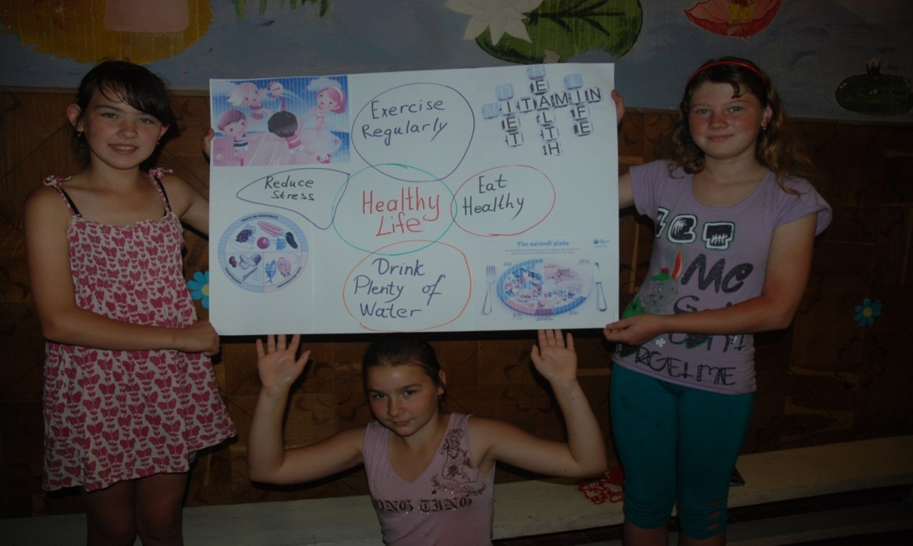
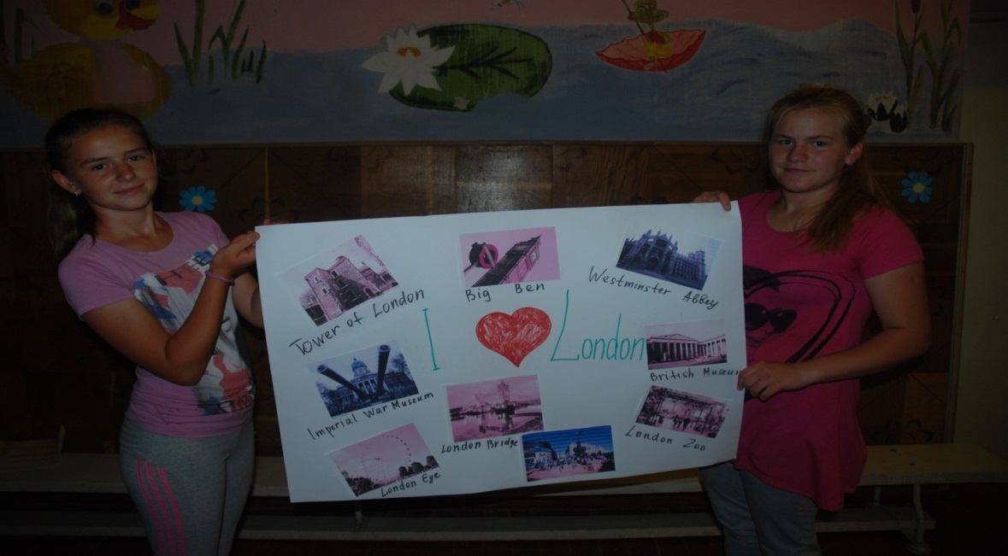
Doing Projects

Slide 16
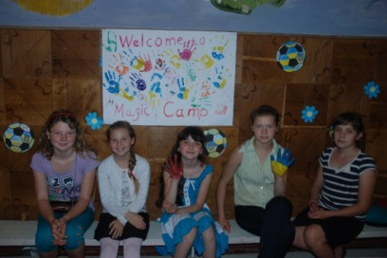
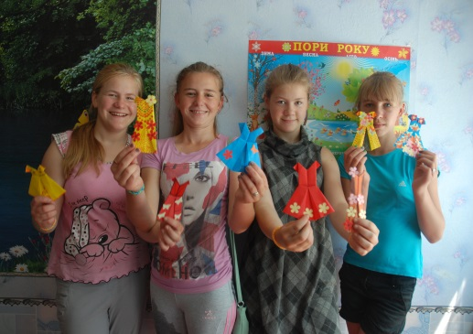
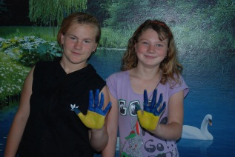
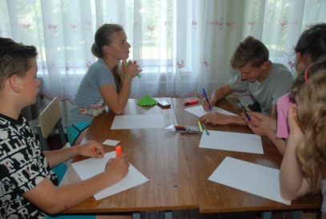
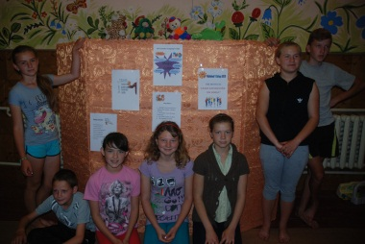
Happy Summer! :)

